Slide 1


OER-LSV-Curve
Ir Nanoparticles Supported on TiN
Wenhao Liu Stonybrook University
Center for Functional Nanomaterials Brookhaven National Laboratory
CME:502
Notes:
Hello, everyone, good morning! I am Wenhao, a new PhD student of FANG & YUGANG. Now I am taking classes two days a week in SBU and doing experiments threes days a week in the CFN. Here I am going to introduce my project: Wet Chemistry Synthesis of Ir Nanoparticles

Slide 2
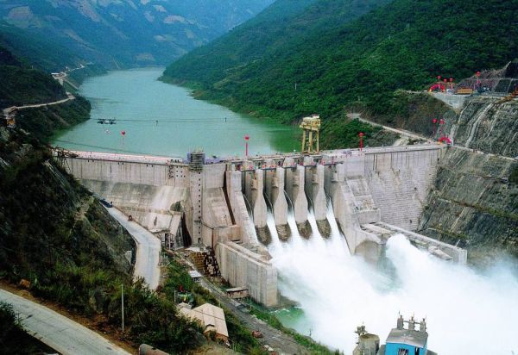
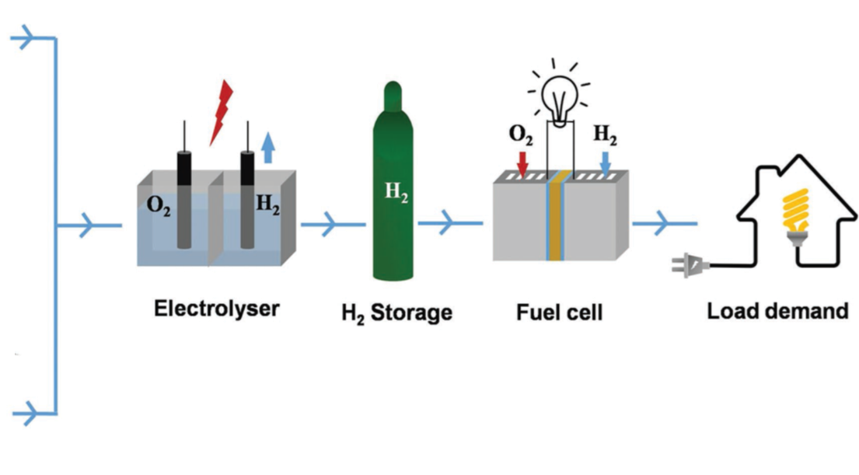
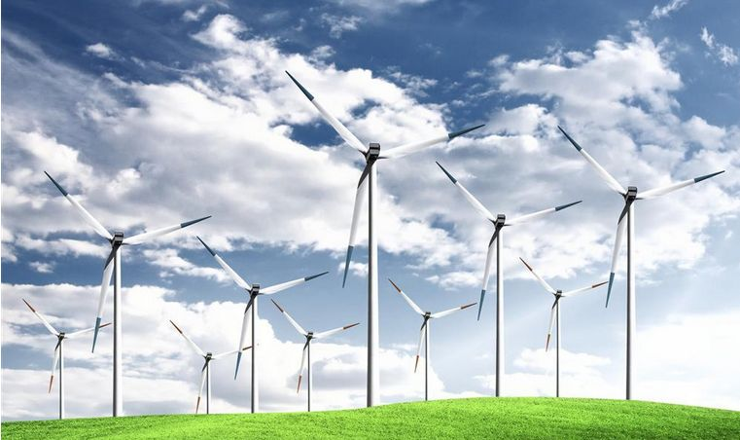

Research Background
Page:1
Notes:
Fist of all, let me briefly introduce the research background.
Reducing the usage platinum group metal in water splitting catalyst is of great significance
Figure 1 is what we proposed in the grant. Currently, we are doing the project A by a colloidal method to synthesize small size of spherical iridium nanoparticles to loading on titanium nitride. In this way, we aim to reduce the loading of platinum group metals, Optimize PGMs utilization, and enhance the mass activity of the catalyst for OER.

Slide 3
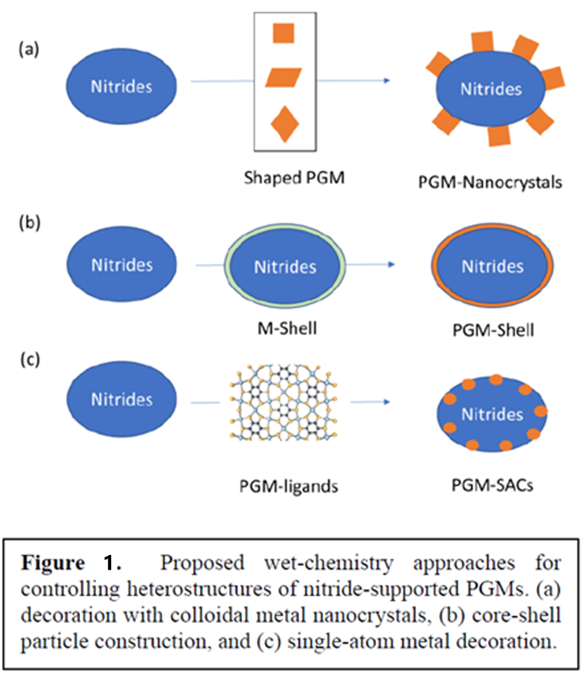
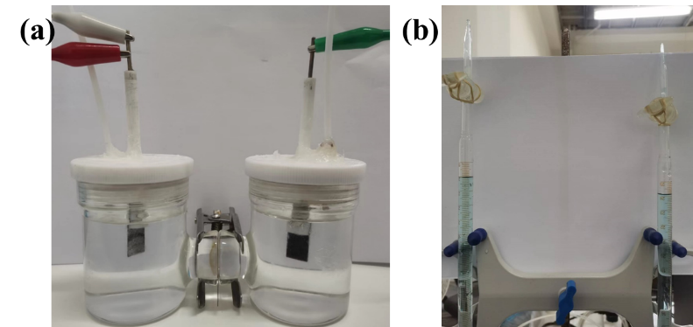
Research Background
Page:2
Reducing the usage PGMs (platinum group metal) in catalyst is of great significance
Notes:
Fist of all, let me briefly introduce the research background.
Reducing the usage platinum group metal in water splitting catalyst is of great significance
Figure 1 is what we proposed in the grant. Currently, we are doing the project A by a colloidal method to synthesize small size of spherical iridium nanoparticles to loading on titanium nitride. In this way, we aim to reduce the loading of platinum group metals, Optimize PGMs utilization, and enhance the mass activity of the catalyst for OER.

Slide 4
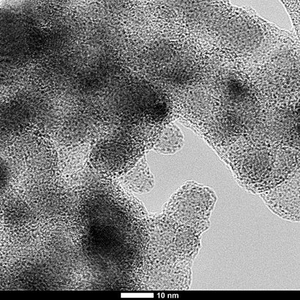
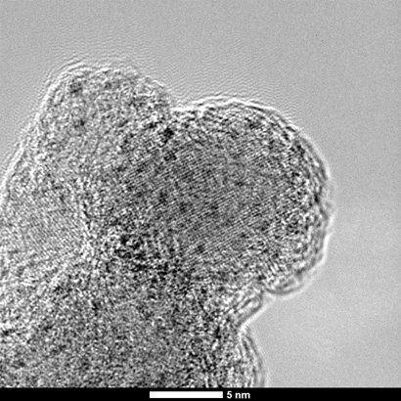
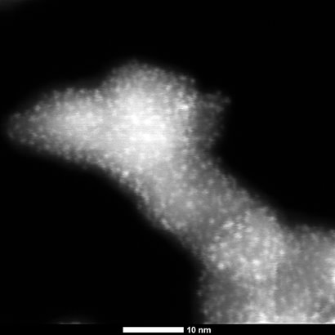
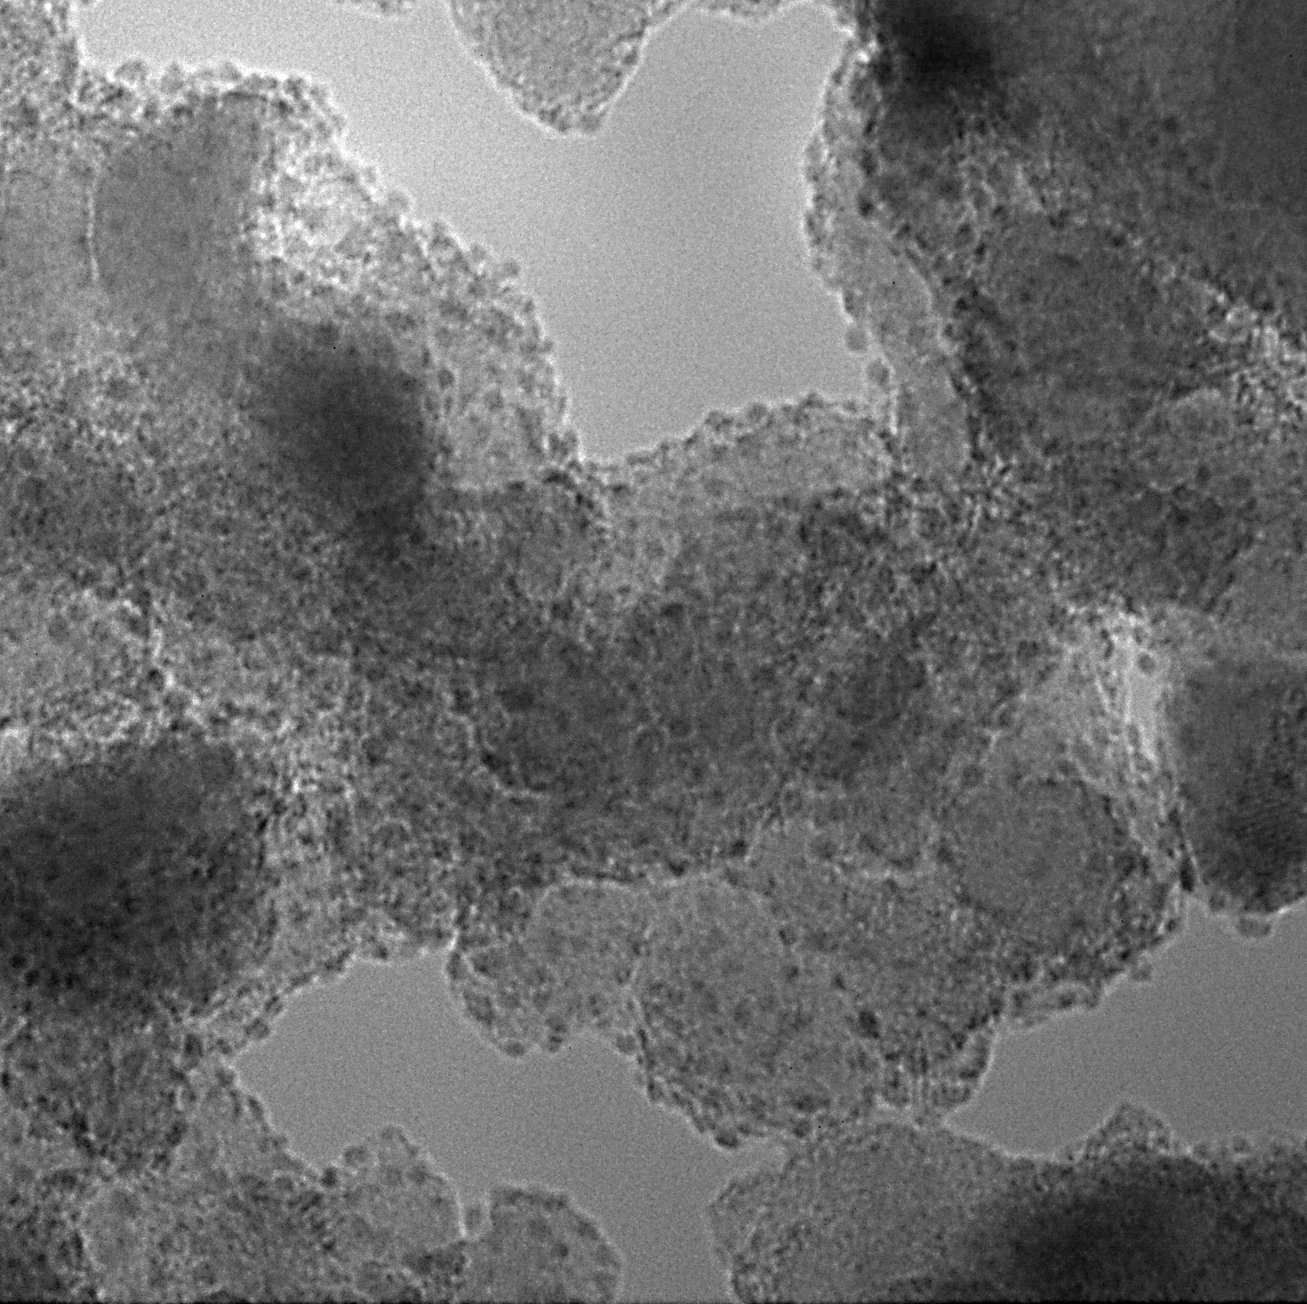
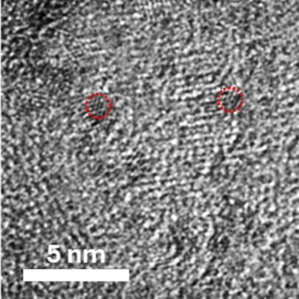
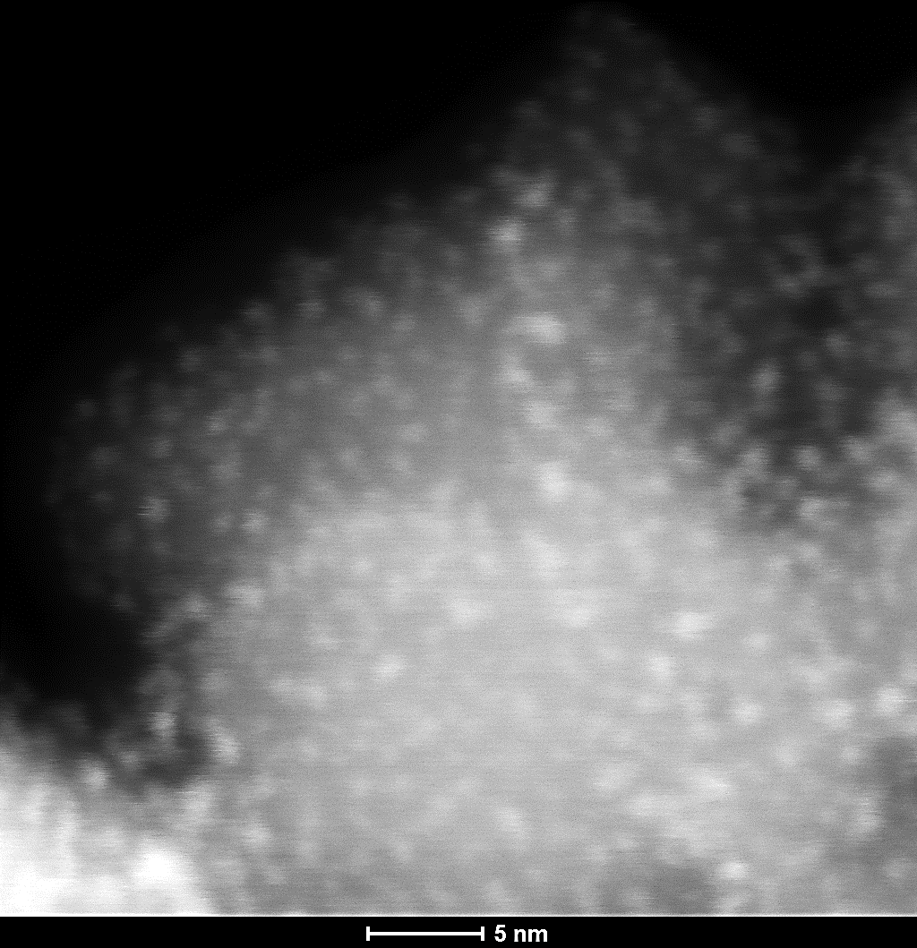
Research Background
Page:3
To increase the loading （sample-B0）:
Optimize chemical recipe , synthesis conditions , chemical post-processing
a
c
e
_{Average size： ~ 0.7 nm}
Three atoms-monolayer， which is calculated as a good state for OER
b
20 nm
5 nm
10 nm
b
d
f
Figure 7. a,b) TEM, c,d) HRTEM, e,f) STEM of sample-B0
10 nm
5 nm

Slide 5
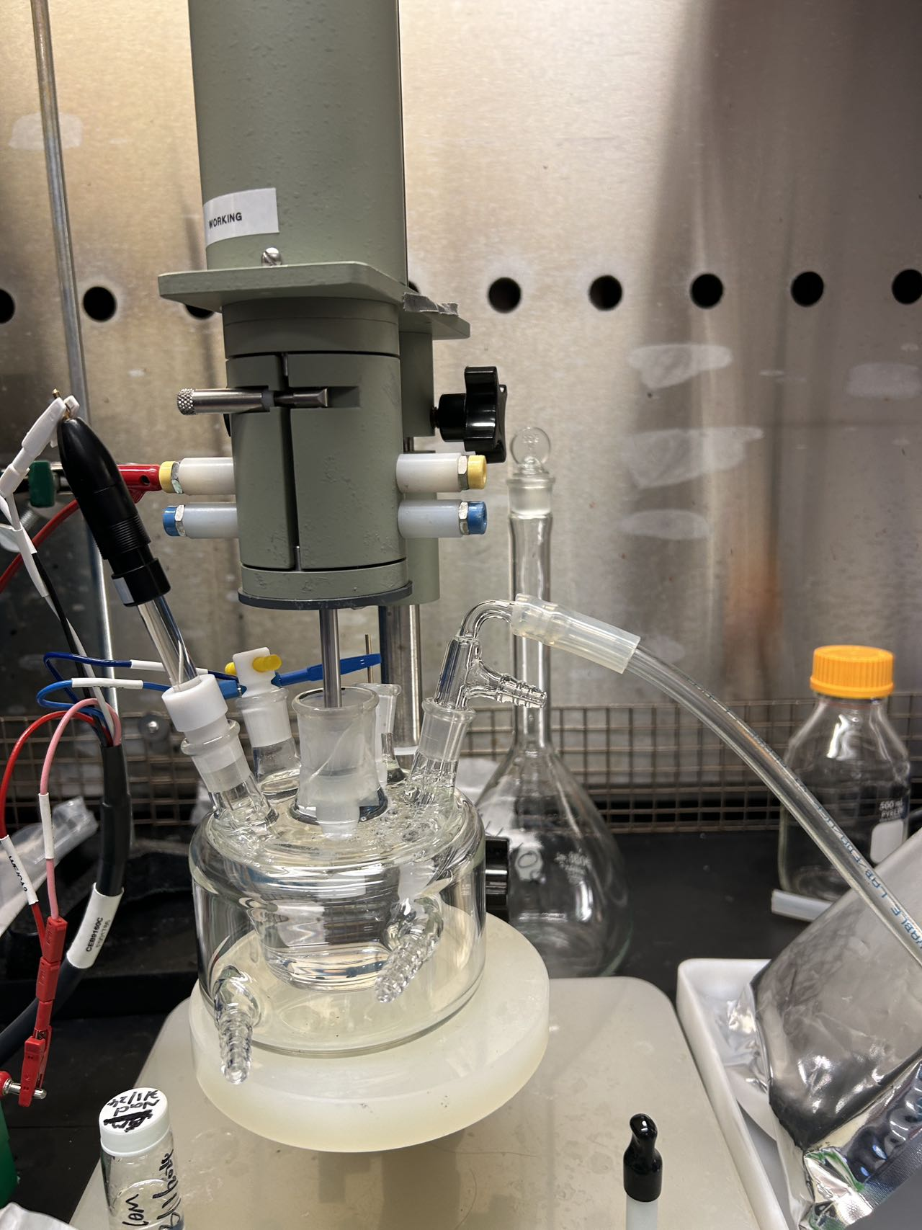
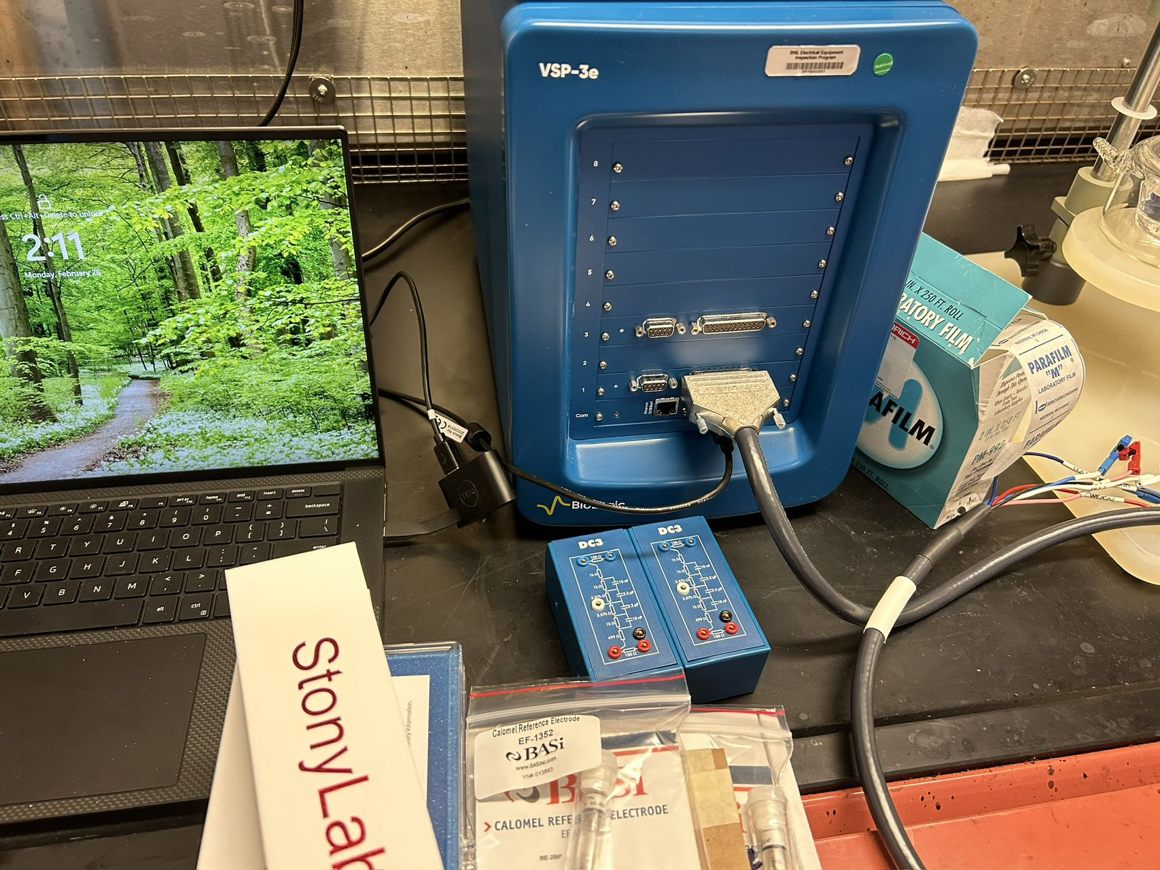
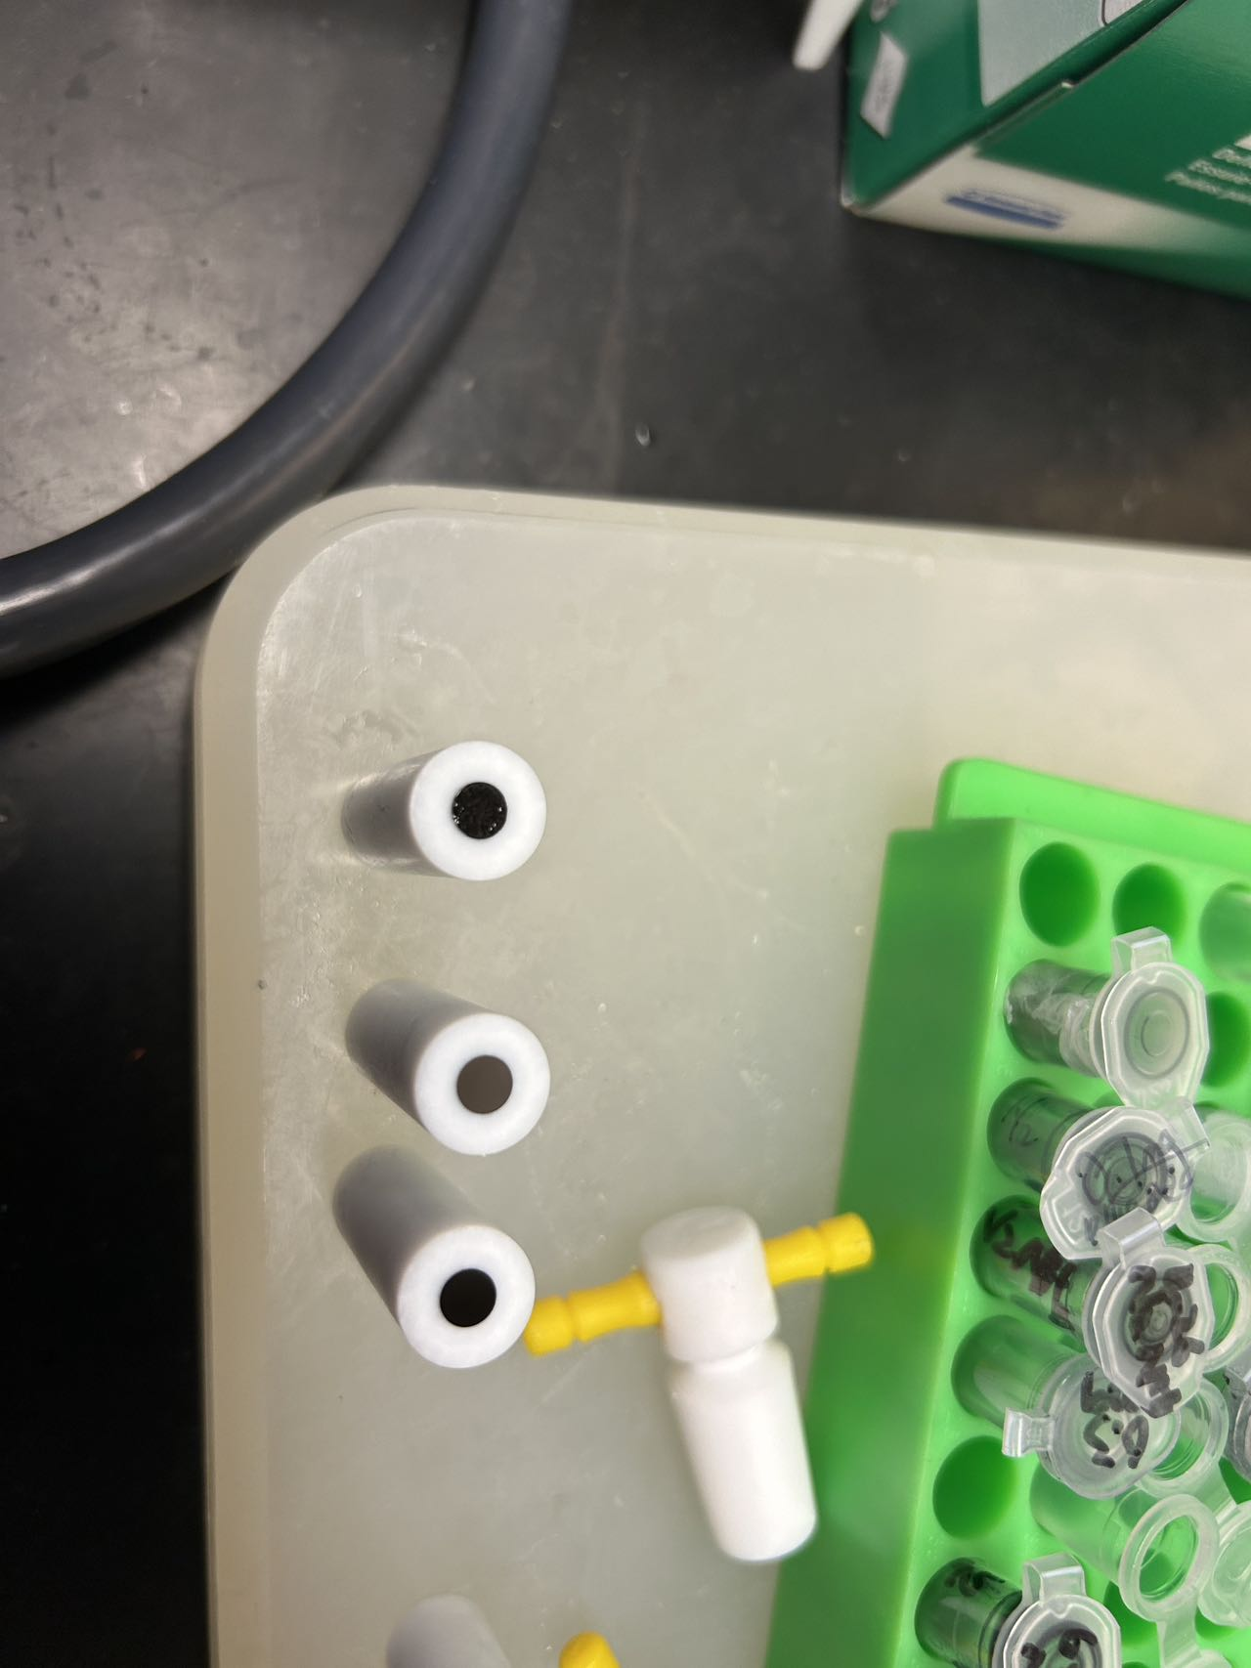
Research Background
Page:4
Notes:
Thank Professor Lu

Slide 6
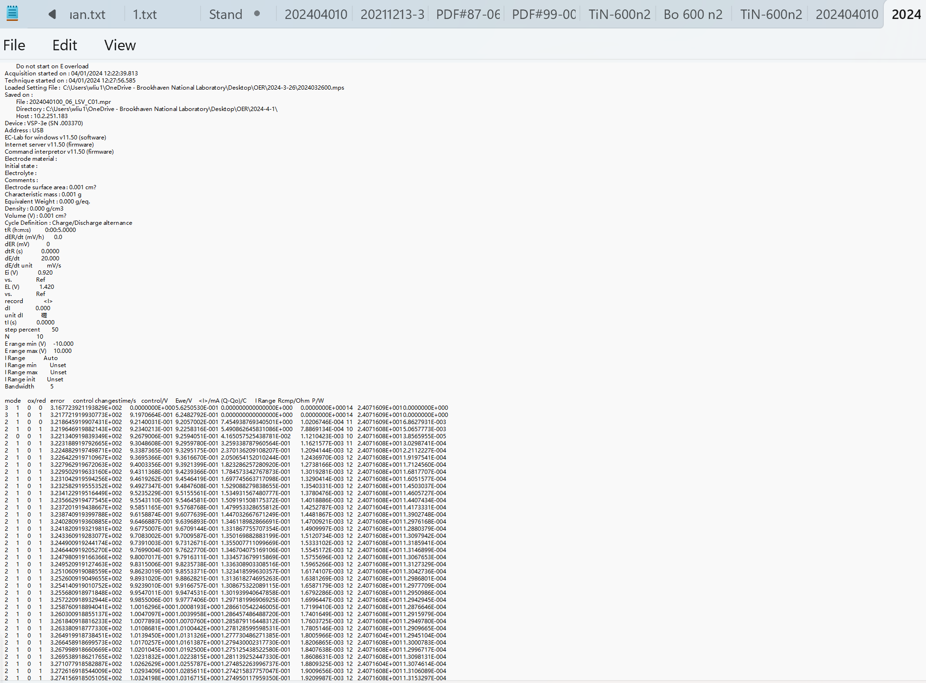
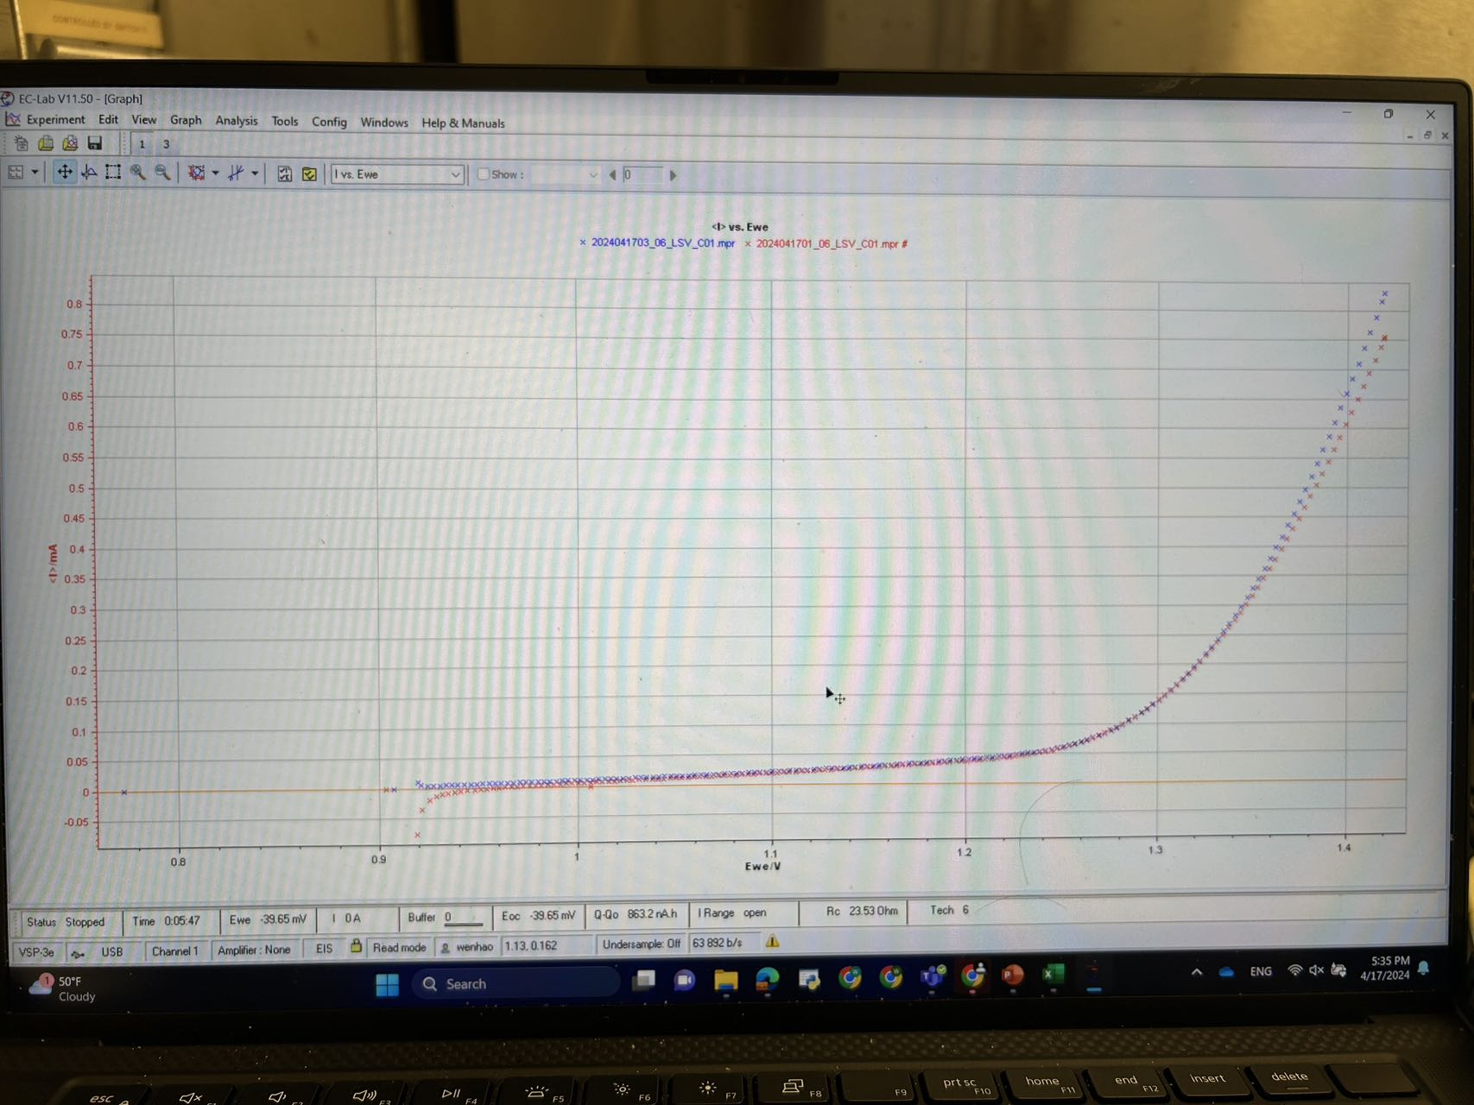
Mathematical Analysis
Page:5
Notes:
Thank Professor Lu

Slide 7
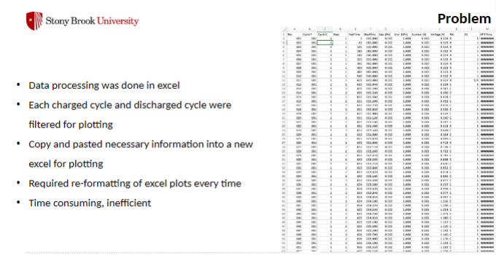
Mathematical Analysis
Page:6
Notes:
Thank Professor Lu

Slide 8
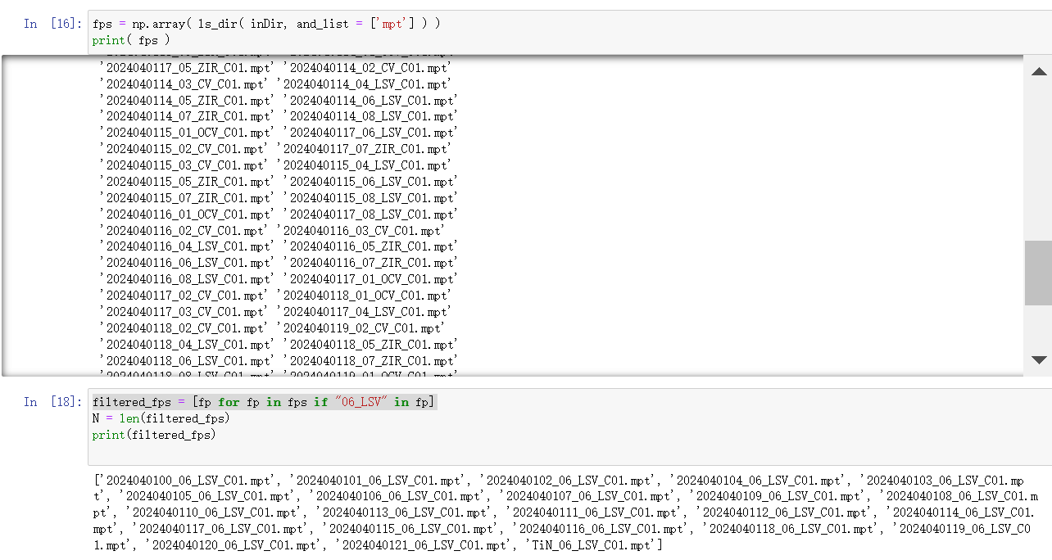
Mathematical Analysis
Page:8
Notes:
Thank Professor Lu

Slide 9
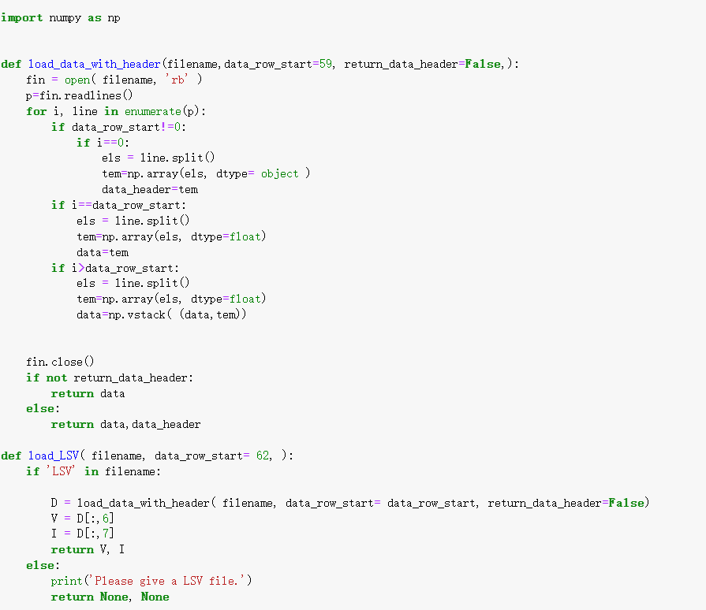
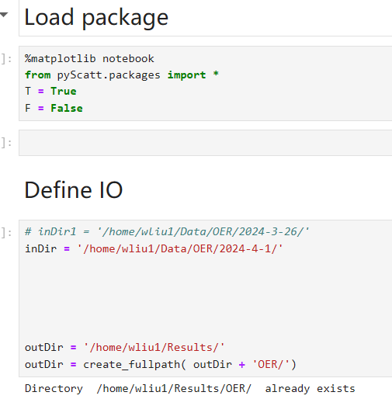
Mathematical Analysis
Page:7
Notes:
Thank Professor Lu

Slide 10
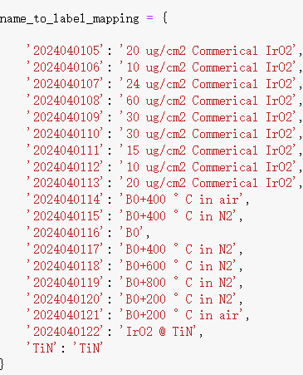
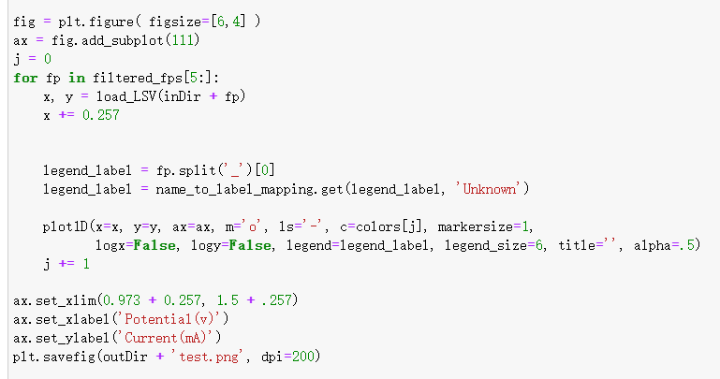
Mathematical Analysis
Page:9
Notes:
Thank Professor Lu

Slide 11
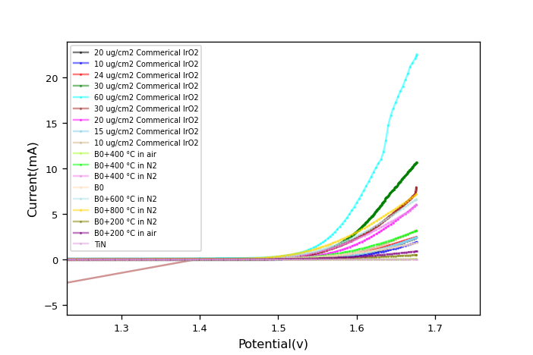
Mathematical Analysis
Page:10
Notes:
Thank Professor Lu

Slide 12
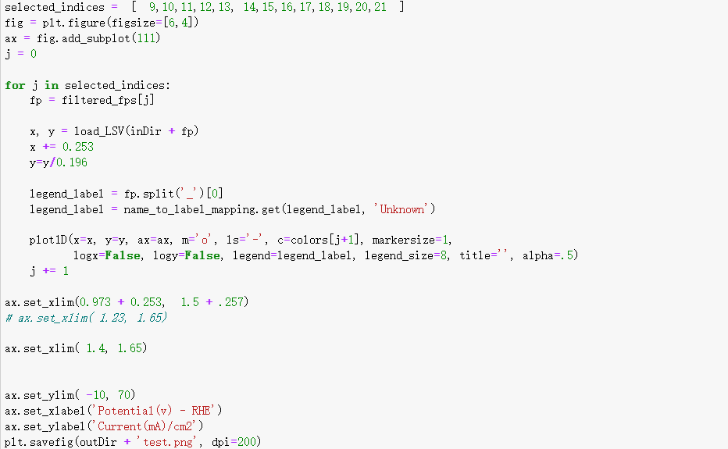
Mathematical Analysis
Page:11
Notes:
Thank Professor Lu

Slide 13
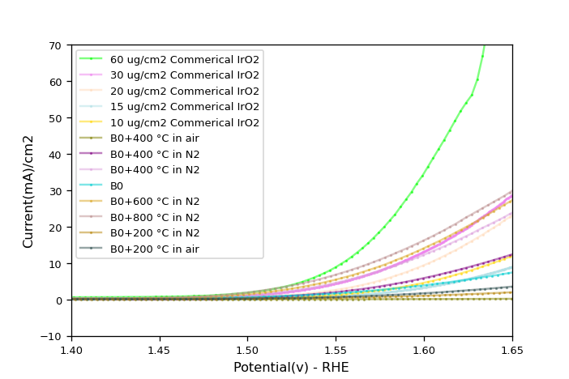
Mathematical Analysis
Page:11
Notes:
Thank Professor Lu

Slide 14
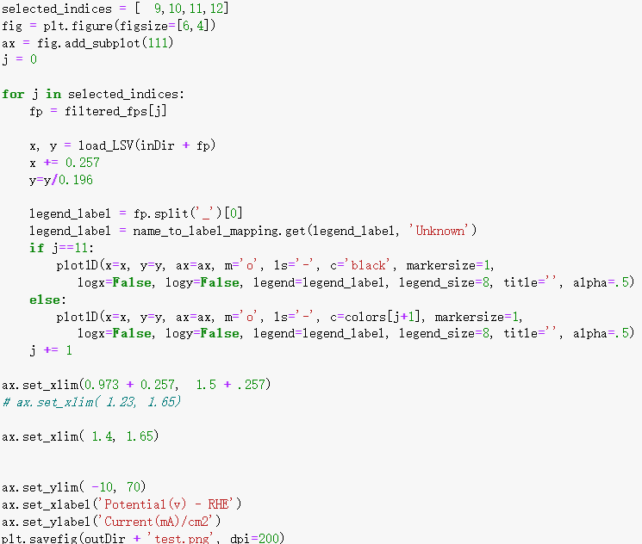
Mathematical Analysis
Page:12
Notes:
Thank Professor Lu

Slide 15
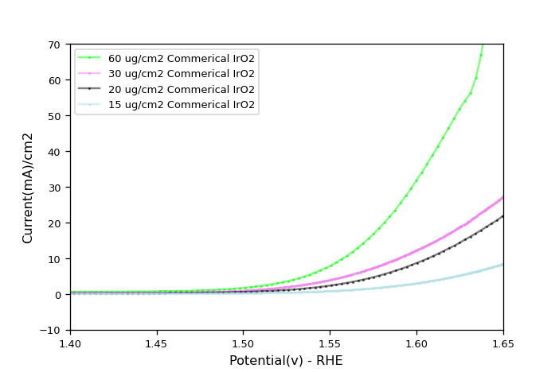
Mathematical Analysis
Page:13
Notes:
Thank Professor Lu

Slide 16
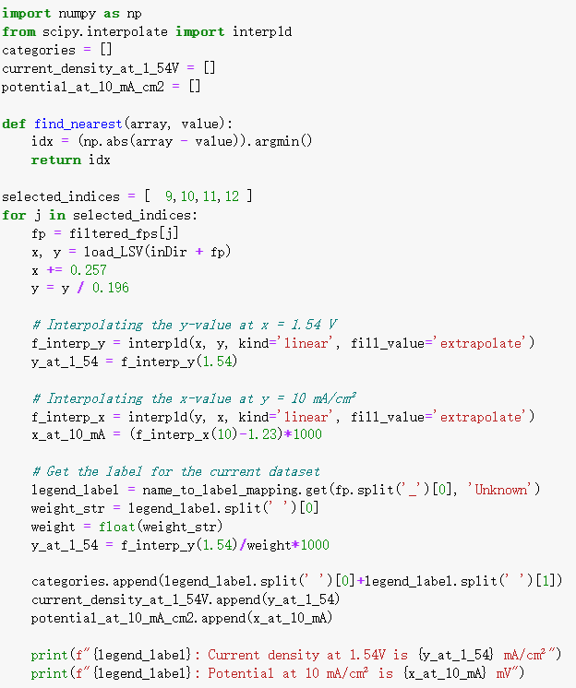
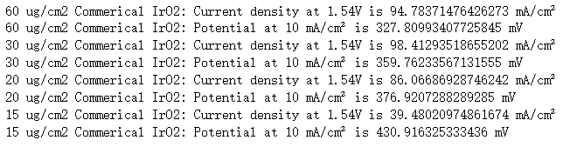
Mathematical Analysis
Page:14
Notes:
Thank Professor Lu

Slide 17
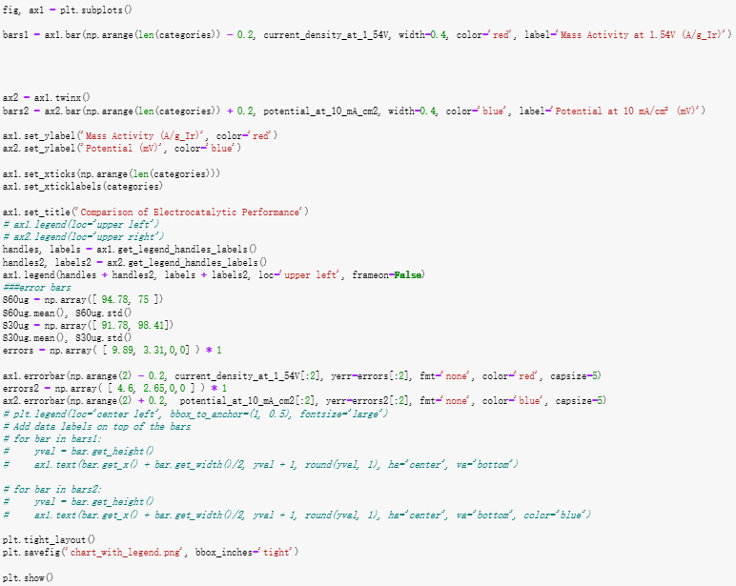
Mathematical Analysis
Page:15
Notes:
Thank Professor Lu

Slide 18
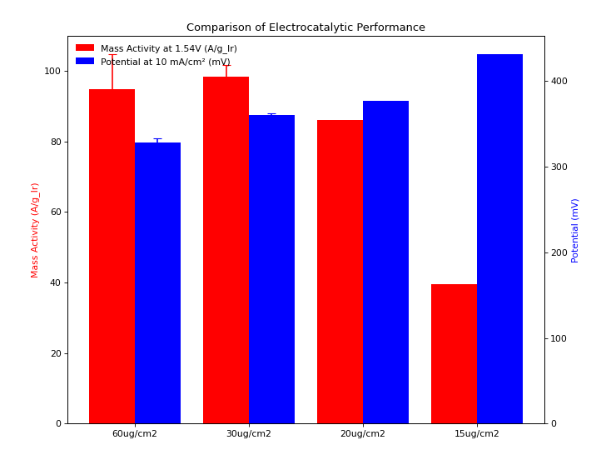
Mathematical Analysis
Page:16
Notes:
Thank Professor Lu

Slide 19
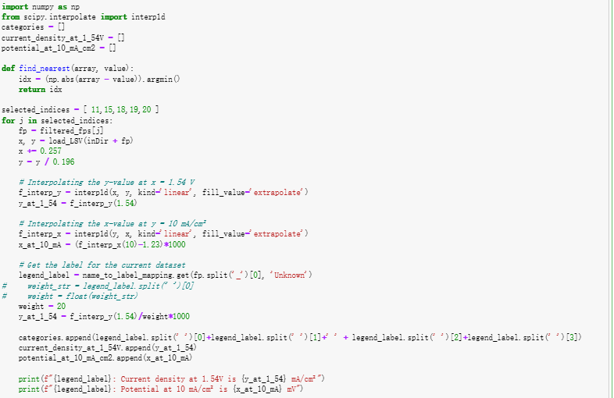
Mathematical Analysis
Page:16
Notes:
Thank Professor Lu

Slide 20
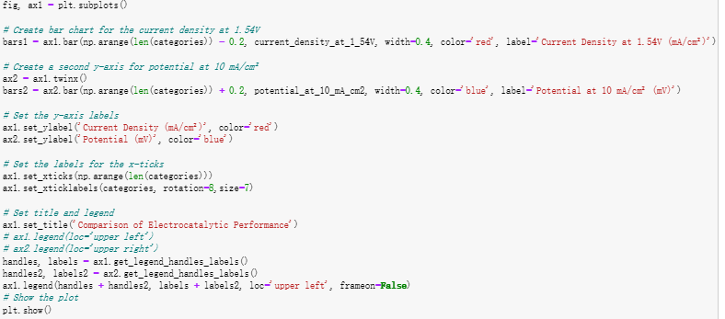
Mathematical Analysis
Page:17
Notes:
Thank Professor Lu

Slide 21
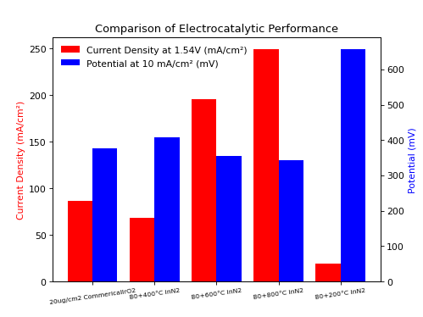
Mathematical Analysis
Page:17
Notes:
Thank Professor Lu

Slide 22
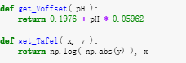
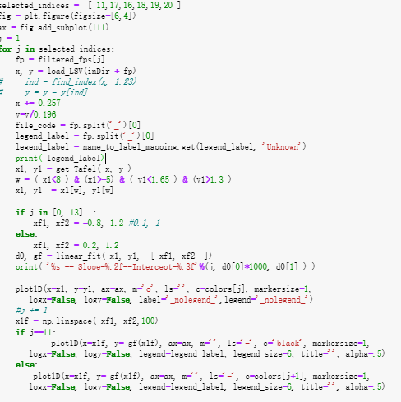
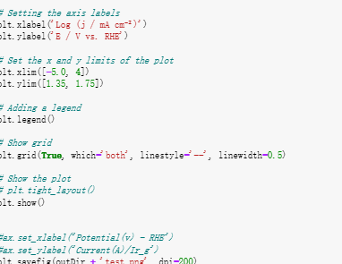
Mathematical Analysis
Page:17
Notes:
Thank Professor Lu

Slide 23
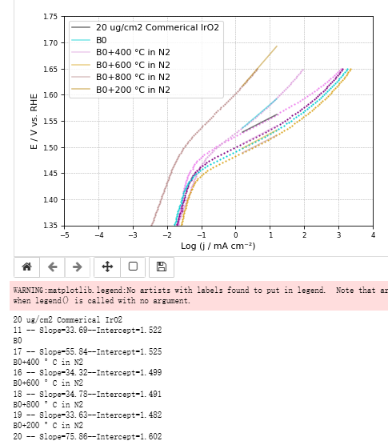
Mathematical Analysis
Page:17
Notes:
Thank Professor Lu

Slide 24
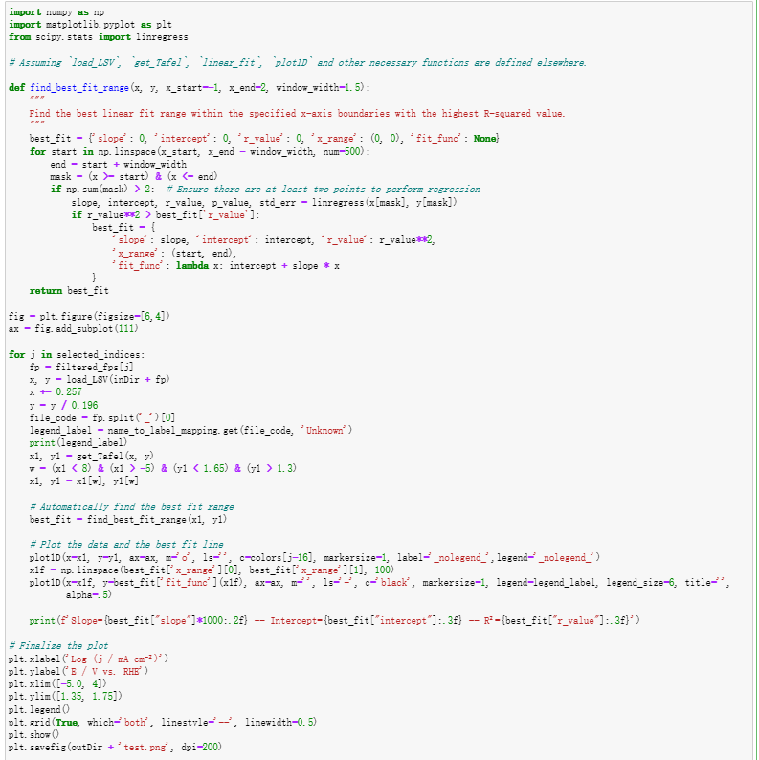
Mathematical Analysis
Page:17
Notes:
Thank Professor Lu

Slide 25
Mathematical Analysis
Page:17
Notes:
Thank Professor Lu

Slide 26
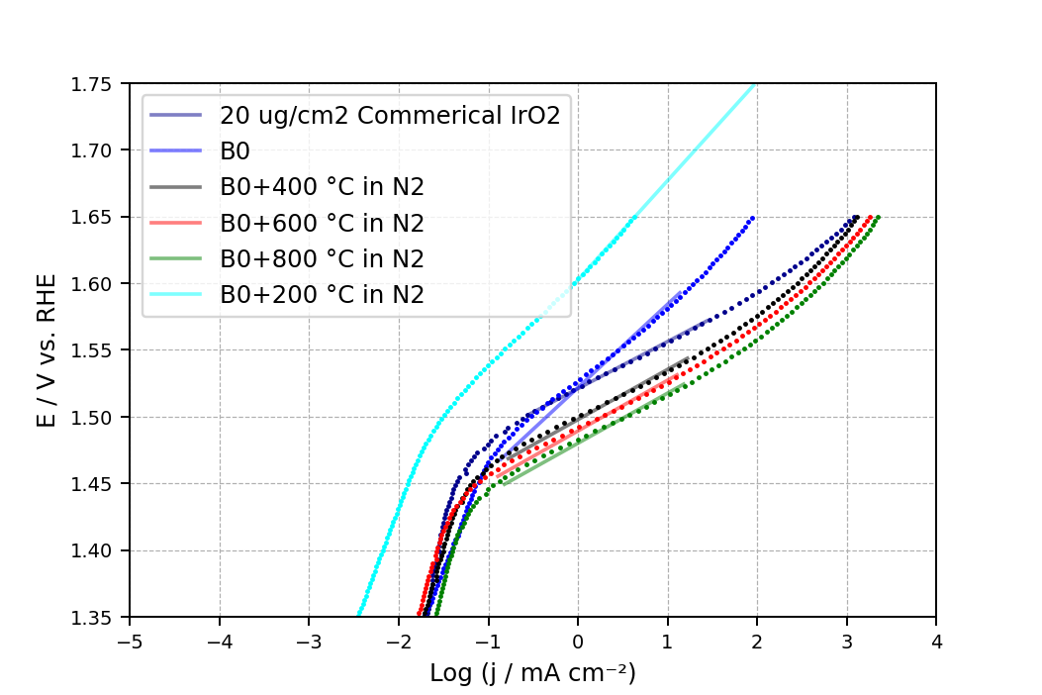
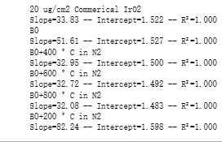
Mathematical Analysis
Page:17
Notes:
Thank Professor Lu

Slide 27
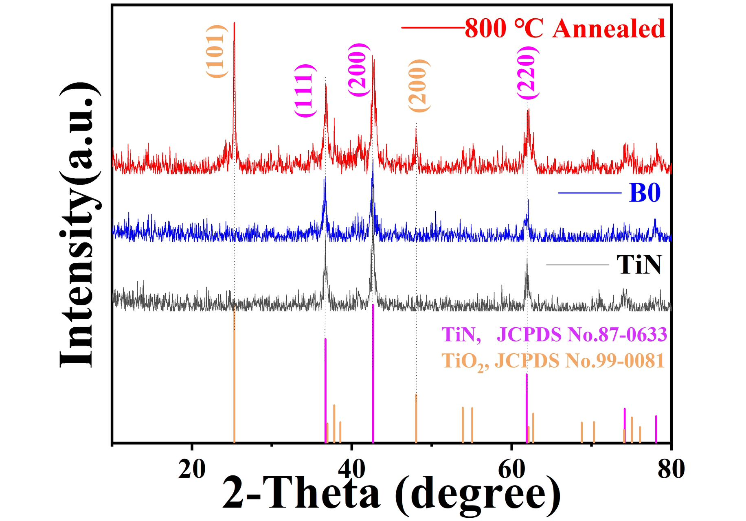
Future
Page:18
Notes:
Thank Professor Lu

Slide 28
References
Page:18
[1] YESTON J., Virtues of splitting up water-splitting[J]. Science, 2017, 356 (6336): 393-394.
[2] MEYER T. J., Catalysis: the art of splitting water[J]. Nature, 2008, 451 (7180): 778-9.
[3] ZHU J., HU L., ZHAO P., et al. Recent advances in electrocatalytic hydrogen evolution using nanoparticles[J]. Chemical Reviews, 2020, 120 (2): 851-918.
[4] ZHANG G. F., WANG A. H., NIU L., et al. Interfacial engineering to construct antioxidative Pd₄S/Pd₃P_{0.95} heterostructure for robust hydrogen production at high current density[J]. Advanced Energy Materials, 2022, 12 (11): 2103511.
[5] CAO DONG, XU HAOXIANG, CHENG DAOJIAN, Construction of defect‐rich RhCu nanotubes with highly active Rh3Cu1alloy phase for overall water splitting in all ph values[J]. Advanced Energy Materials, 2020, 10 (9): 1903038.
[6] LI YUN, LI RUOPENG, WANG DAN, et al. A review: Target-oriented transition metal phosphide design and synthesis for water splitting[J]. International Journal of Hydrogen Energy, 2020, 46 (7): 5131-5149.
[7] ZHANG Z., FENG C., LI X., et al. In-situ generated high-valent iron single-atom catalyst for efficient oxygen evolution[J]. Nano Letter, 2021, 21 (11): 4795-4801.
[8] XIA L., PAN K., WU H., et al. Few-layered WS₂ anchored on Co, N-doped carbon hollow polyhedron for oxygen evolution and hydrogen evolution[J]. ACS Applied Materials & Interfaces, 2022, 14 (19): 22030-22040.
[9] ZHANG A., LIANG Y., ZHANG H., et al. Doping regulation in transition metal compounds for electrocatalysis[J]. Chemical Society Reviews, 2021, 50 (17): 9817-9844.
[10] YUAN W. Y., WANG S. Y., MA Y., et al. Interfacial engineering of cobalt nitrides and mesoporous nitrogen-doped carbon: toward efficient overall water-splitting activity with enhanced charge-transfer efficiency[J]. ACS Energy Letters, 2020, 5 (3): 692-700.
[11] VATTIKUTI S. V. P., DEVARAYAPALLI K. C., REDDY NALLABALA N. K., et al. Onion-ring-like carbon and nitrogen from zif-8 on tio₂/fe₂o₃ nanostructure for overall electrochemical water splitting[J]. Journal of Physical Chemistry Letters, 2021, 12 (25): 5909-5918.
Notes:
Thank Professor Lu

